Slide 1
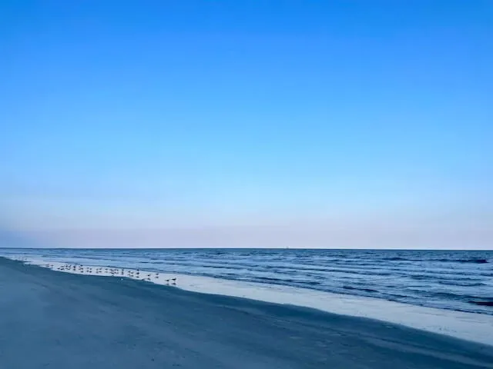
Geoengineering
Kiawah Island
----------------------

Slide 2
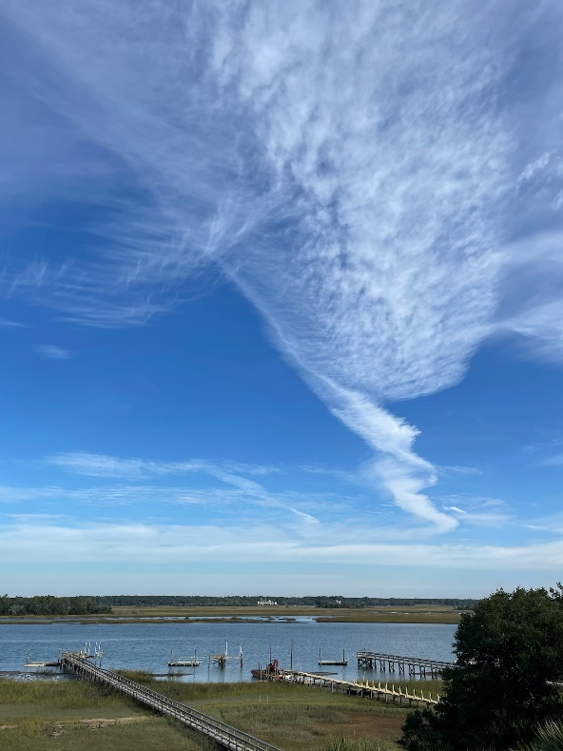
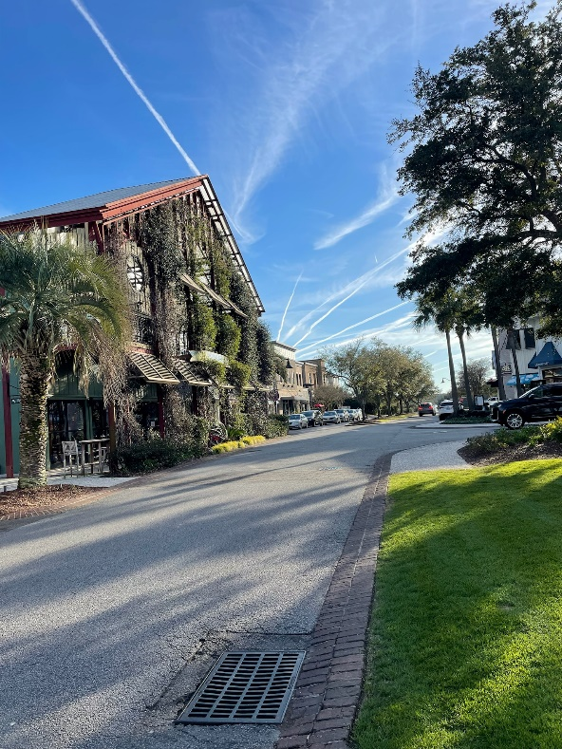
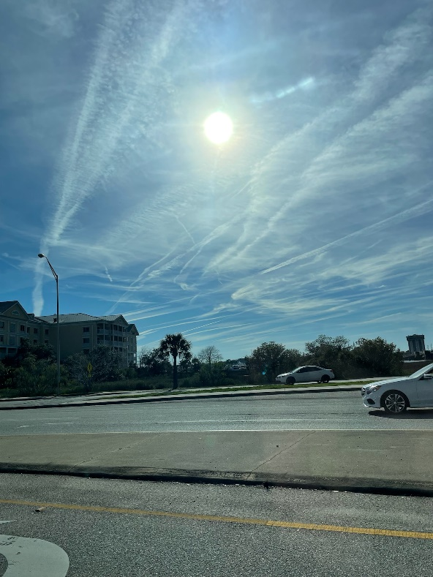
Geoengineering
Definition: Is a blanket term for climate and weather modification. Solar geoengineering is the term used for the process of slowing global warming by reflecting solar radiation back into space and/or blocking out the sun, by way of SAI.

Slide 3
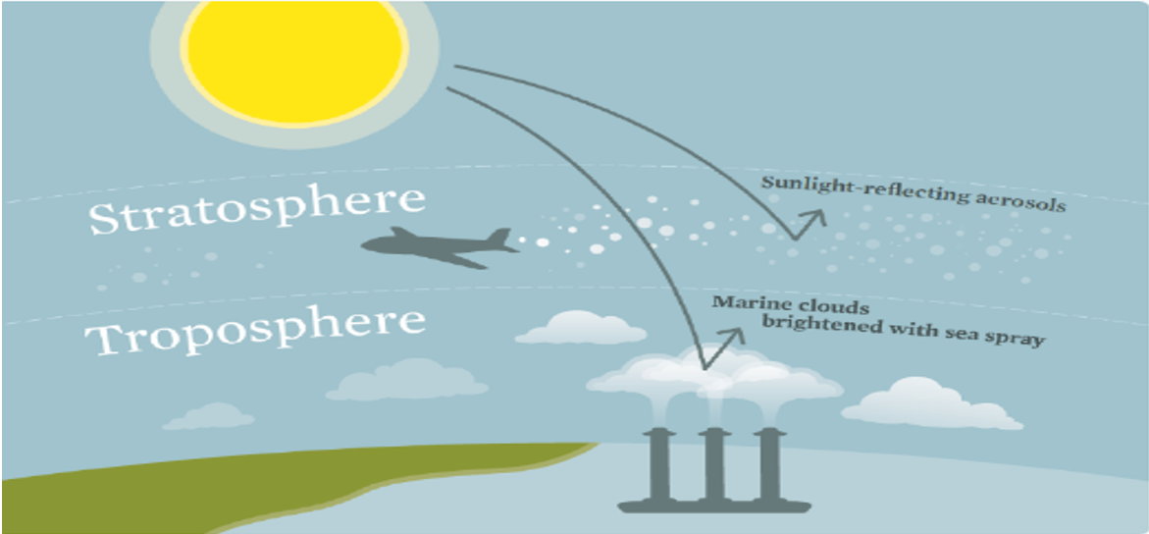
Stratospheric Aerosol Injections

Slide 4
2016 PupMed Article State the Following:
Solar Radiation Management
SAI Include (2016)
Environmental sulfates
Black carbon
Metallic aluminum
Aluminum oxide aerosols
Barium Titanate
Sulfur dioxide
Adverse public health impacts are to be expected
Little is known of the toxicity of aerosols
There is no consensus regarding acceptable levels of exposer
There is little to no infrastructure in place to evaluate impacts of SAI Aerosols on public health
https://www.ncbi.nlm.nih.gov/pmc/articles/PMC4717532/

Slide 5
Risks
SRM/SAI: According to Dr. Alan Robock and others, testimony in 2009 Congressional Hearings before the Committee on Science and Technology House of Representatives and Scientific Journal Reflecting the Sun’s Rays 2021
RISKS
Ozone Depletion
No more ‘Blue Bird’ Skies
Environmental impacts: such as crop failure/ vegetation loss
Commercial control
Human error
Human health impacts
Soil, Air, and water contamination
Acidification of rain
Changes in precipitation patterns

Slide 6
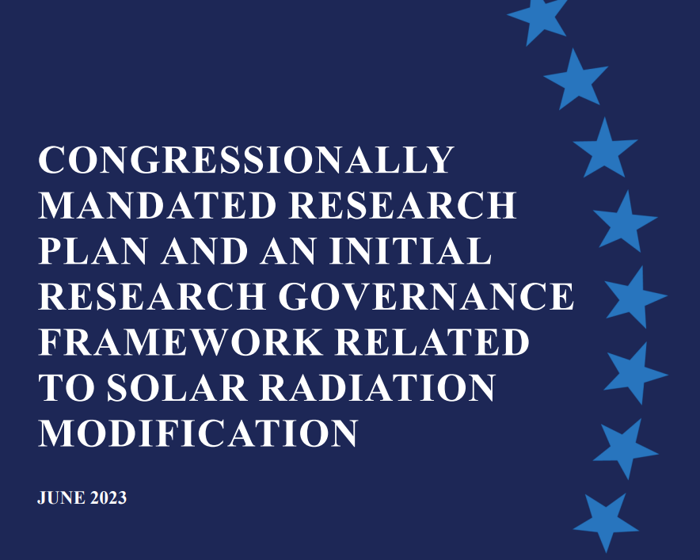
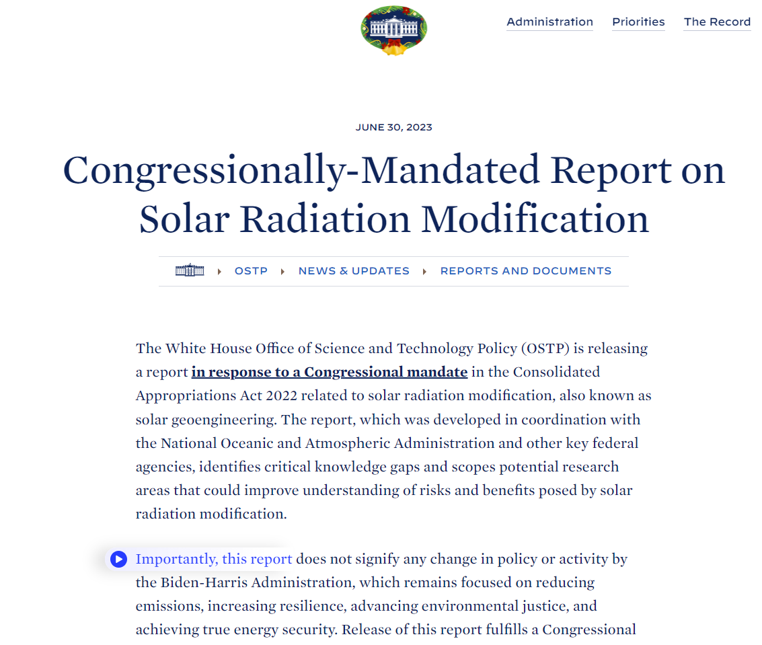

Solar Radiation Mgmt Plan
https://www.whitehouse.gov/ostp/news-updates/2023/06/30/congressionally-mandated-report-on-solar-radiation-modification/

Slide 7
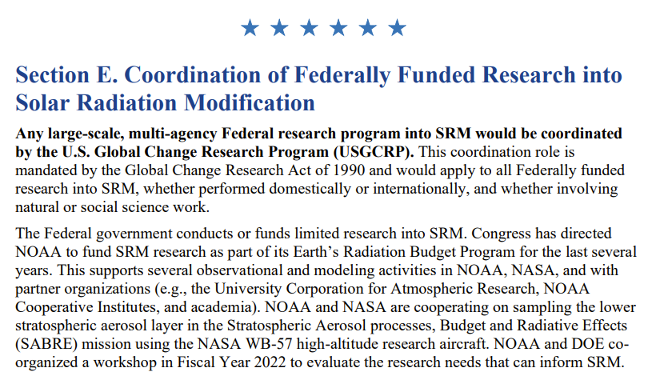
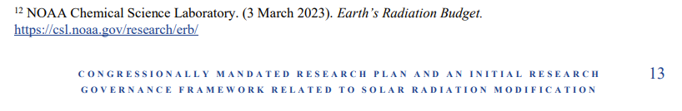
Biden Solar Radiation Mgmt Plan
https://www.whitehouse.gov/ostp/news-updates/2023/06/30/congressionally-mandated-report-on-solar-radiation-modification/

Slide 8
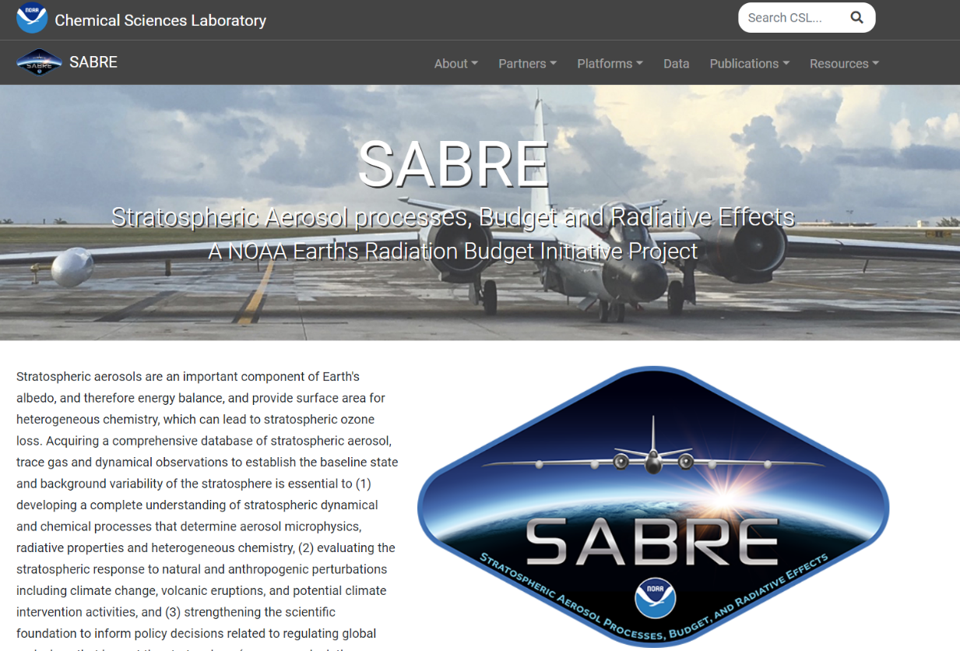
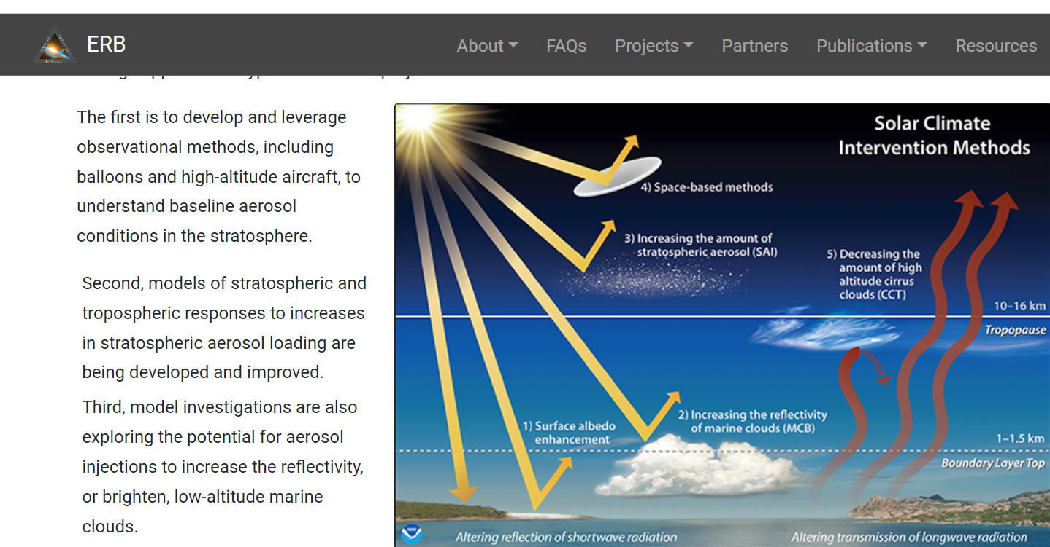
NOAA’S Project SABRE
https://csl.noaa.gov/projects/sabre/

Slide 9
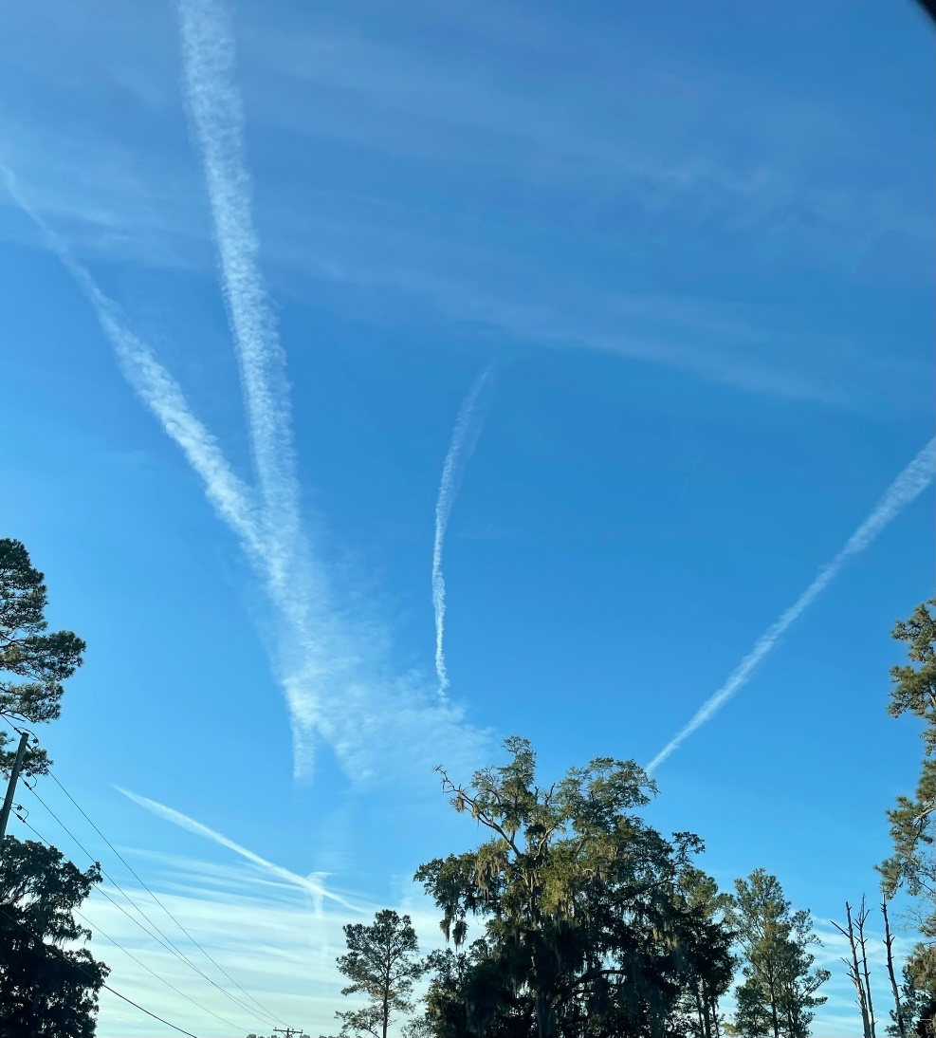
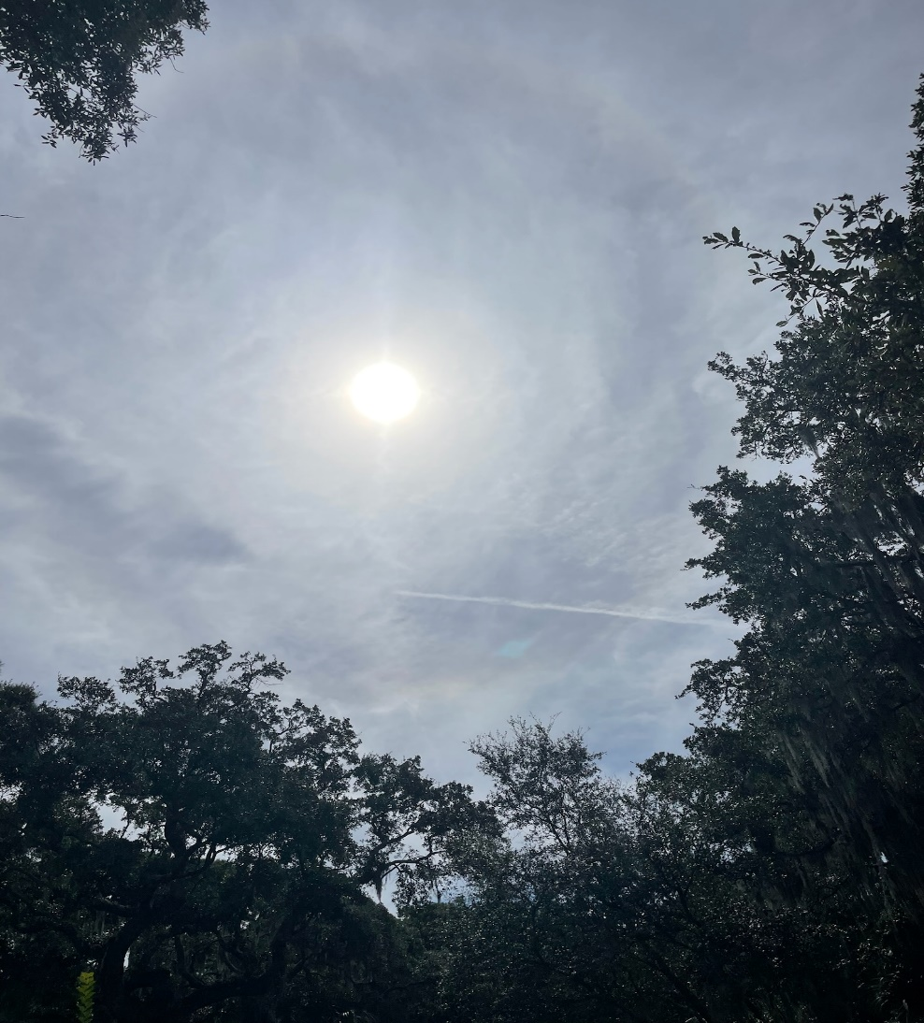
Videos & Photos
11/30/23 6:45 AM
11/30/23 12:07 PM

Slide 10
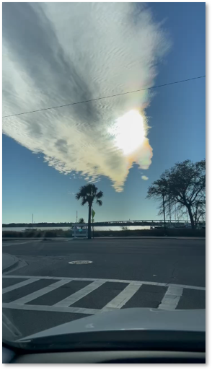
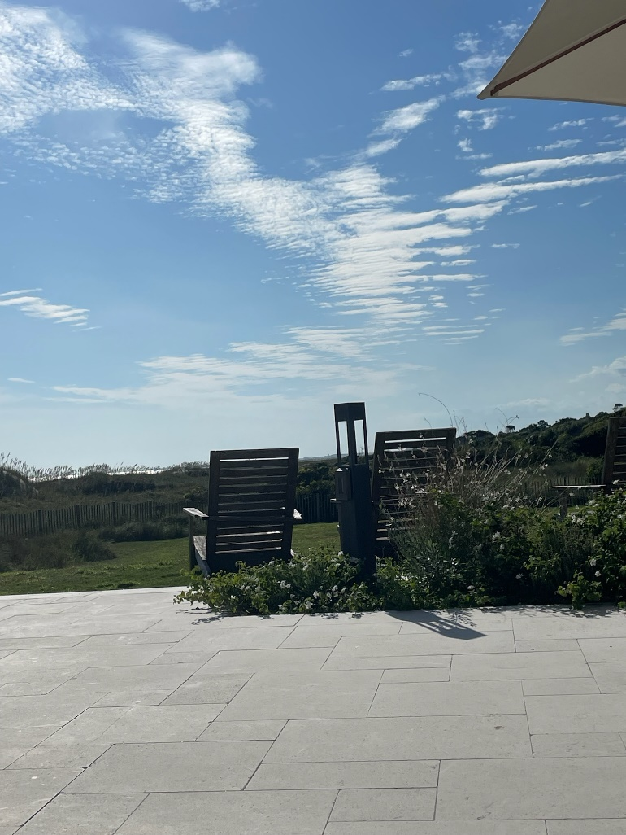
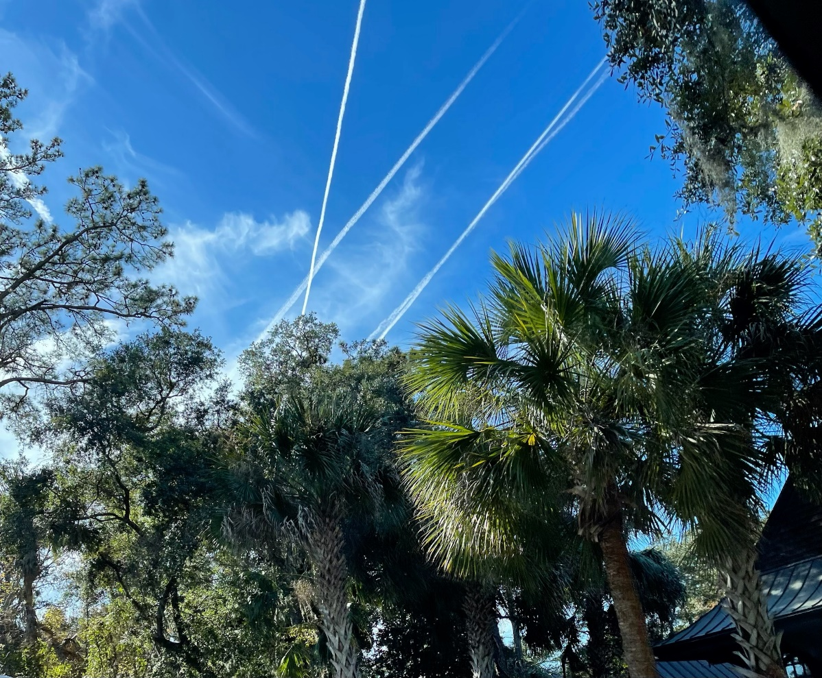
Videos & Photos
Kiawah Beach
Charleston
Kiawah

Slide 11
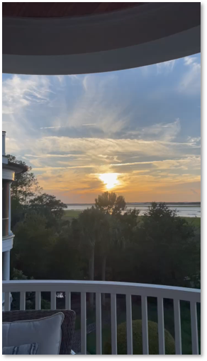
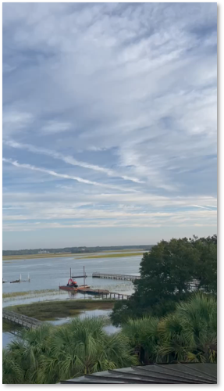
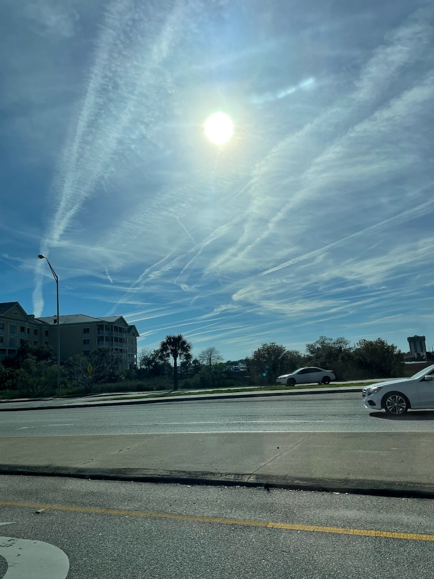
Videos & Photos
Kiawah River
Kiawah River
Charleston

Slide 12

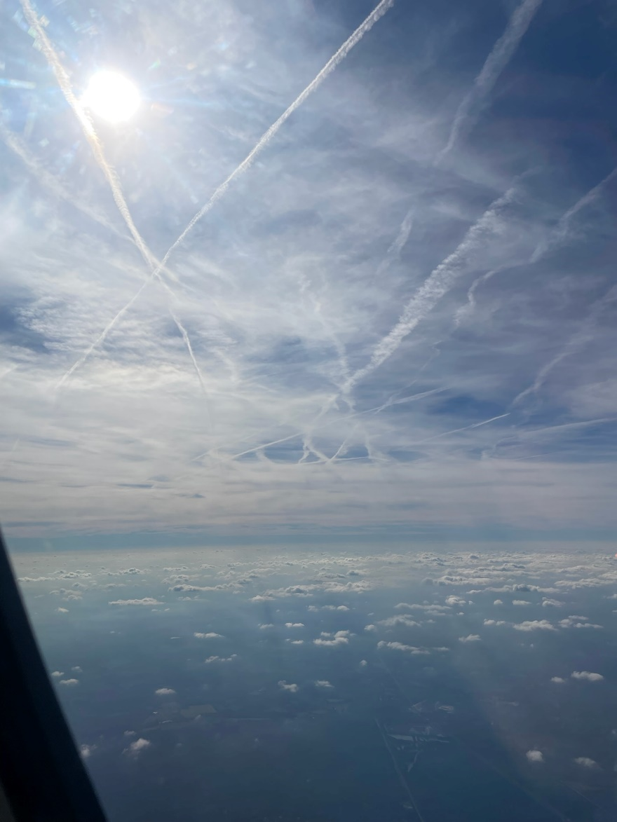
Videos & Photos
Freshfields
Skies Over South Carolina

Slide 13
Condensation
Condensation lasts for a few seconds at the most a minutes
Does not spread out in a thick white haze
Does not favor the sun’s position
Stratosphere and upper troposphere have very little to no humidity
I purposely chose photos and videos of varying humidity

Slide 14
My Concerns
My family’s health
The health of my community
Blue skies
Vegetation health
Crop consumption
Property value
Golf course conditions

Slide 15
Towns Who Are Taking Action
Fairfax, CA. In 2012 the town became a chemical trail free zone.
Rhode Island proposal HB 5866 of 2023.

Slide 16
What can we do?
What Kiawah Town Leaders do?
Inform and educate residents on what is being done to our blue skies
Put a Town Ordinance in Place completely banning SAI and Marine Cloud Whitening or have strict regulations.
Include the town, be very transparent on steps being taken to protect residents from SAI contamination.
Form a committee to monitor progress
How can I help the council moving forward?

Slide 17
Appendix
Slide 4 – 2016 PupMed Article State the Following
https://www.ncbi.nlm.nih.gov/pmc/articles/PMC4717532/
https://www.ncbi.nlm.nih.gov/pmc/articles/PMC4717532/
Effiong U, Neitzel RL. Assessing the direct occupational and public health impacts of solar radiation management with stratospheric aerosols. Environ Health. 2016 Jan 19;15:7. doi: 10.1186/s12940-016-0089-0. PMID: 26786592; PMCID: PMC4717532.
Slide 6 & 7 – Biden/White House SRM Plan
https://www.whitehouse.gov/ostp/news-updates/2023/06/30/congressionally-mandated-report-on-solar-radiation-modification/
Slide 8 – Project SABRE
https://csl.noaa.gov/projects/sabre/

